Slide 1









FLEX
Team L
Your own Food & Workout assistant

Slide 2
TABLE OF CONTENTS
01
02
03
04
Overall Progress
Completed tasks
Project Challenge
& Solution
Next week plan

Slide 3
01
Overall Progress

Slide 4
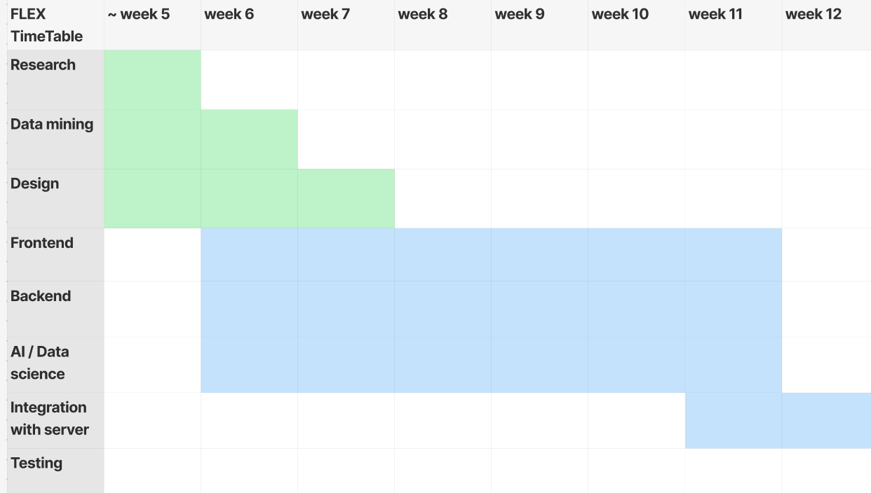
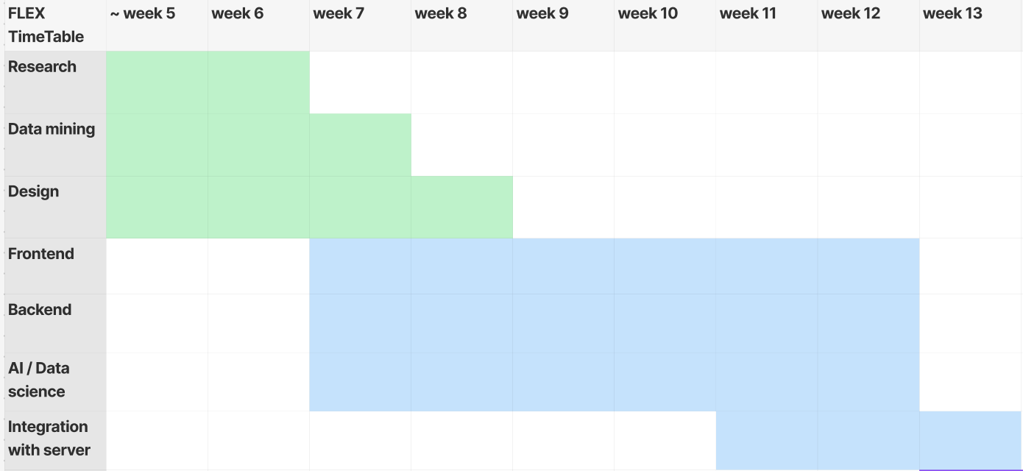
Overall Progress
We encountered conflicts as we aimed to refine our development process towards a more effective recommendation system, while also facing the limitations of a restricted dataset.
As a result, our schedule was delayed by a week.

Slide 5
02
Completed tasks

Slide 6
Tasks Completed This Week
Backend
Database Design Modification
User Input related API
User Info API
Frontend
Main, Chat, Exercise chart, login, register page
AI
Make 70% accuracy nlp model
Resolve problem of Refrigerator image analysis

Slide 7
02-1
Backend

Slide 8


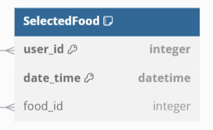
Database Design Modification
Added “registered_allergy” field to “User” Table for users who didn’t confirm their allergies.
Also modified logic about login and getting allergy information from users.
Added “SelectedFood” Table for saving what users ate.

Slide 9
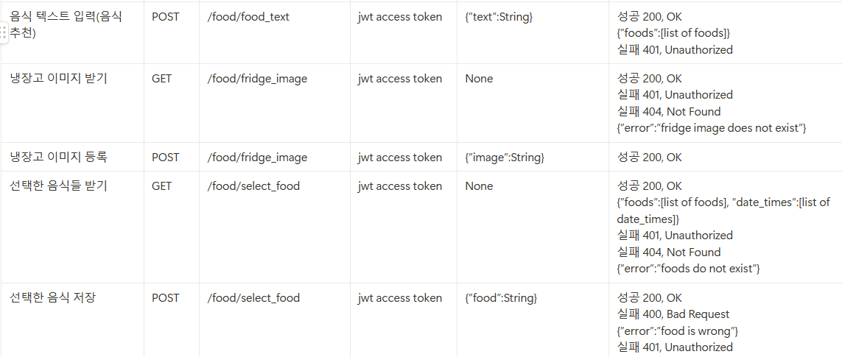
User Input related API
Saving users’ text, image, selected food input

Slide 10
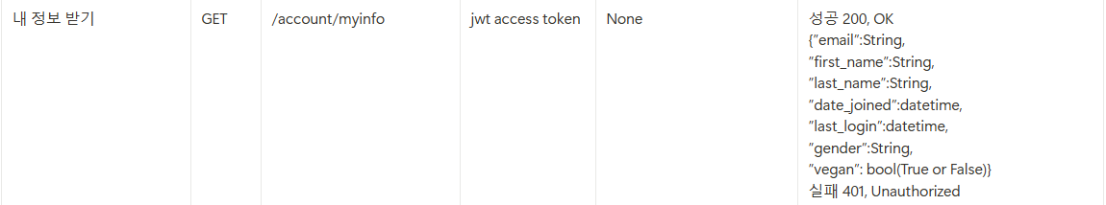
User Info API
Response users’ personal information

Slide 11
02-2
Frontend

Slide 12
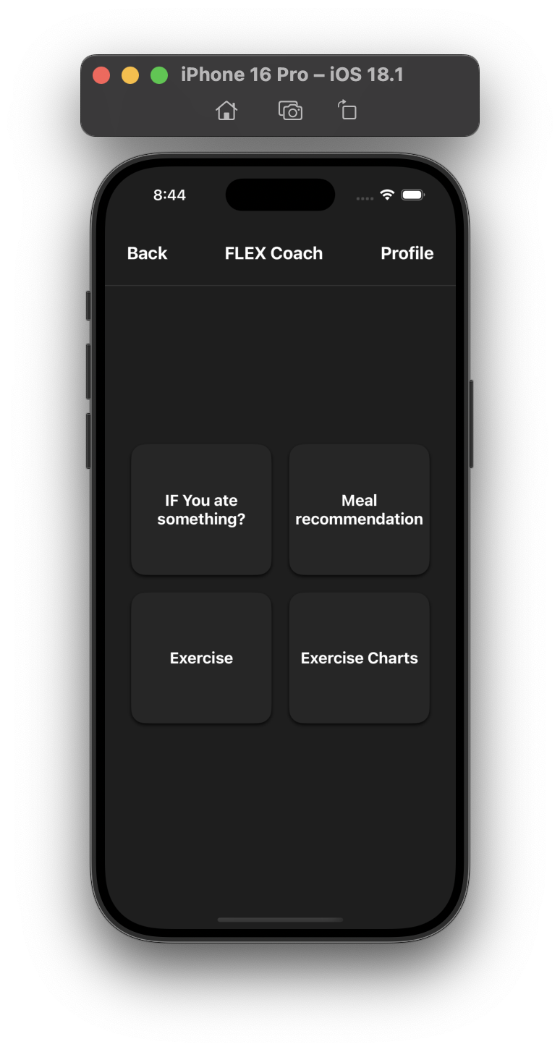
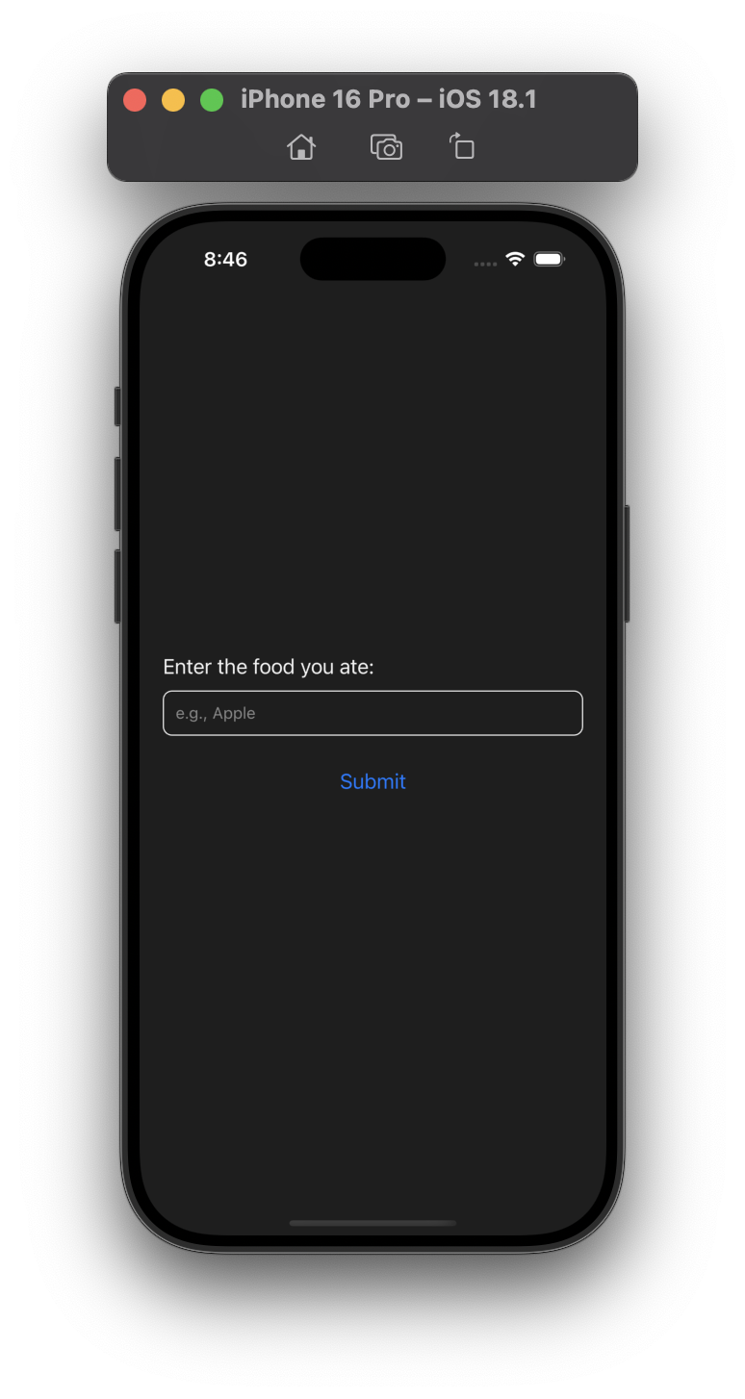
Main - Already ate
If user have meal already, Then just get input what user ate.

Slide 13
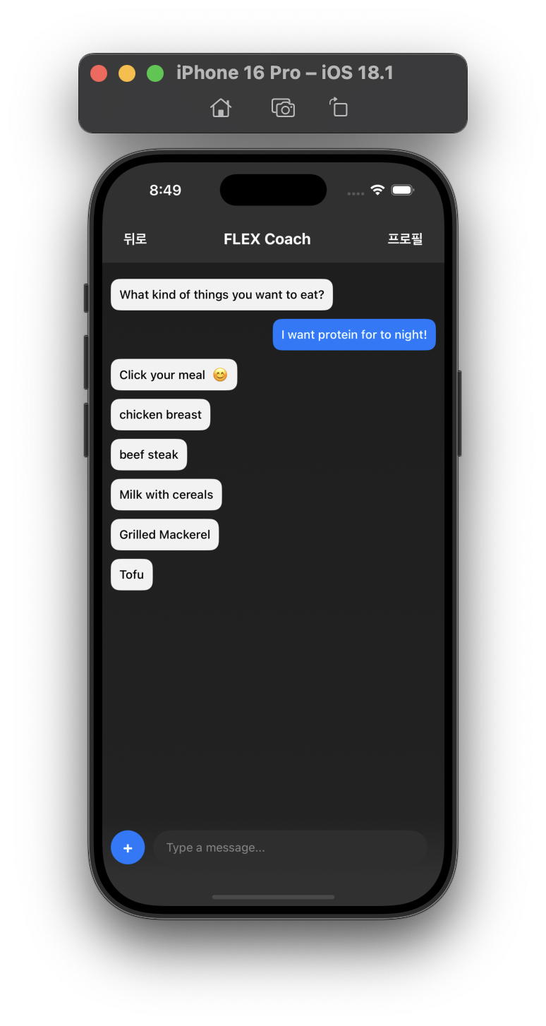
Main - Recommendation
If user send message,
Server give choices .
Pick -> chosen one is saved in DB, chatting is over.

Slide 14
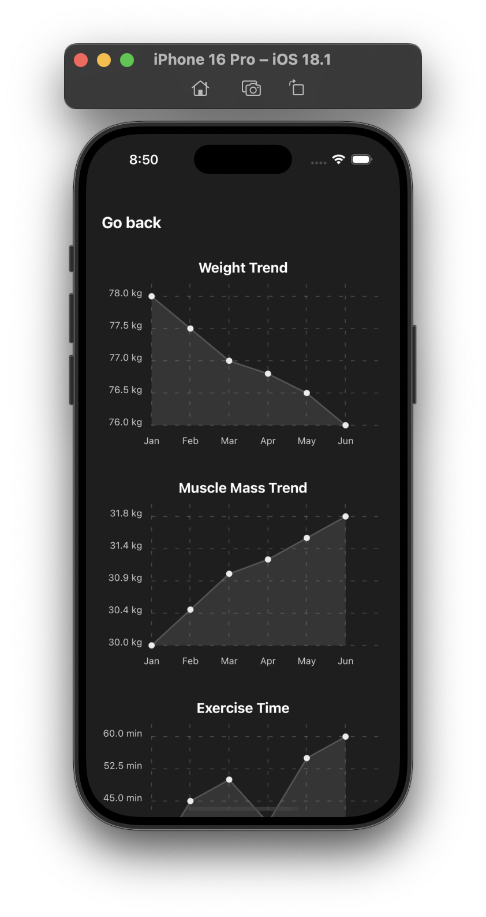
Main - Exercise Charts
Charts are implemented by scroll page.
We show
weight trend
Muscle Mass trend
Partial Muscle Mass trend
Exercise time
Calorie burn, intake data

Slide 15
02-3
AI
Keyword Extraction

Slide 16
Description keywords
Tokenize ✅
Eliminate stopwords ✅
Lemmatize ✅
POS tagging → NN ✅
Entities ✅
Eliminate repeats ✅
Eliminate some noise (n<2) ✅

Slide 17
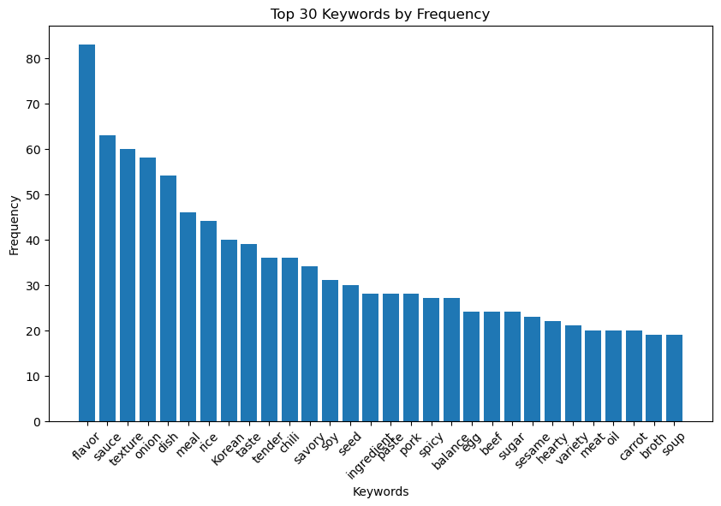
Description keywords

Slide 18
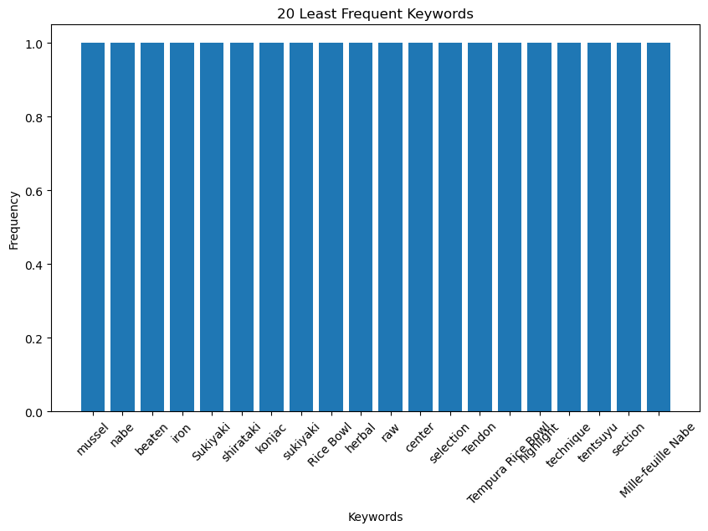
Description keywords

Slide 19
Message keywords
Chat GPT → Create small dataset to evaluate our method
Example:
Message: I feel like eating something spicy tonight.
Positive Keywords: spicy
Negative Keywords: None

Slide 20
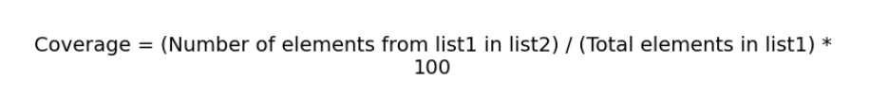
Message keywords
Same way as description → 53%
Looking for same keywords as descriptions’ keywords set → 61%
Combining both → 71%
Coverage percentage →
Noise keywords → Useless if description keywords are alright

Slide 21
Sentiment Analysis
Same small Chat GPT dataset
50% Accuracy
Neutral keywords problem
Chat GPT for training DeBERT?

Slide 22
03
Project Challenge & Solution

Slide 23
Project Challenge 1
How we handle when user ate food which is not exist in our DB?
Or write input with neutral text? ( ex. Chicken )
Solution: We give choices to select. And user need to choose in choices If food is not exist -> just calculate with proper value

Slide 24
Project Challenge 2
Hard to consider how much user eat.
Solution: Just get user for how much he usually eat, and use this for calculating
If user eat much more or less -> user should write after meal how much he ate

Slide 25
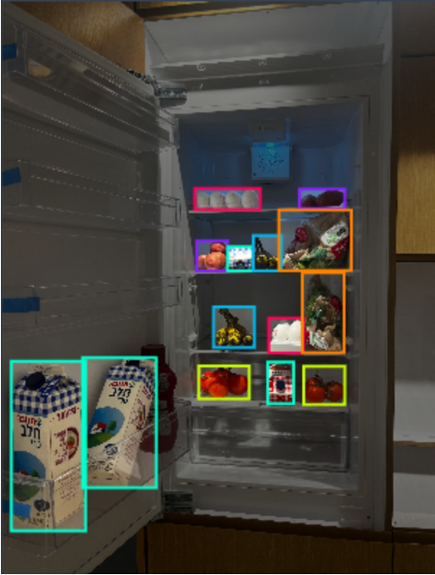
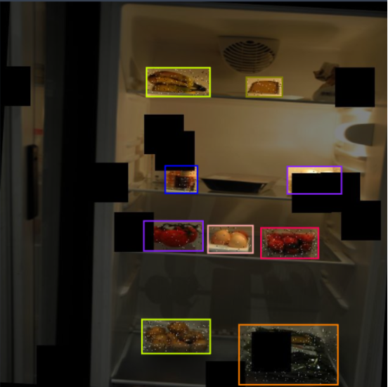
Project Challenge 3
Limitations of the Refrigerator Dataset

Slide 26
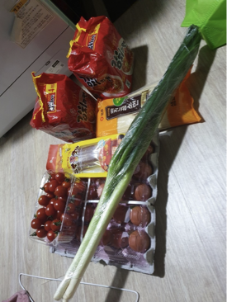
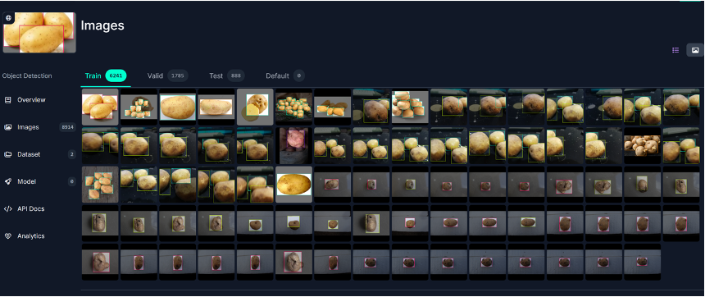
Project Challenge 3
Resolution

Slide 27
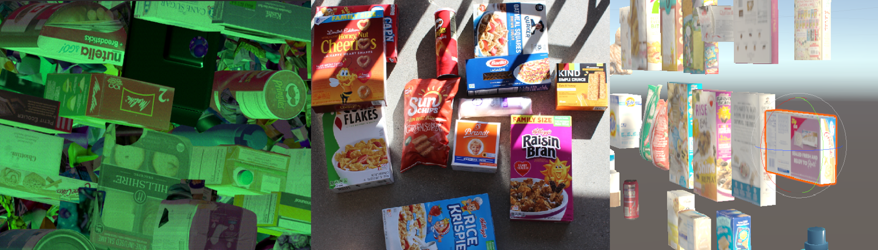
Project Challenge 3
Resolution
-Data augmentation(image synthesis)

Slide 28
Project Challenge 3
Resolution
-Data augmentation(image synthesis)

Slide 29
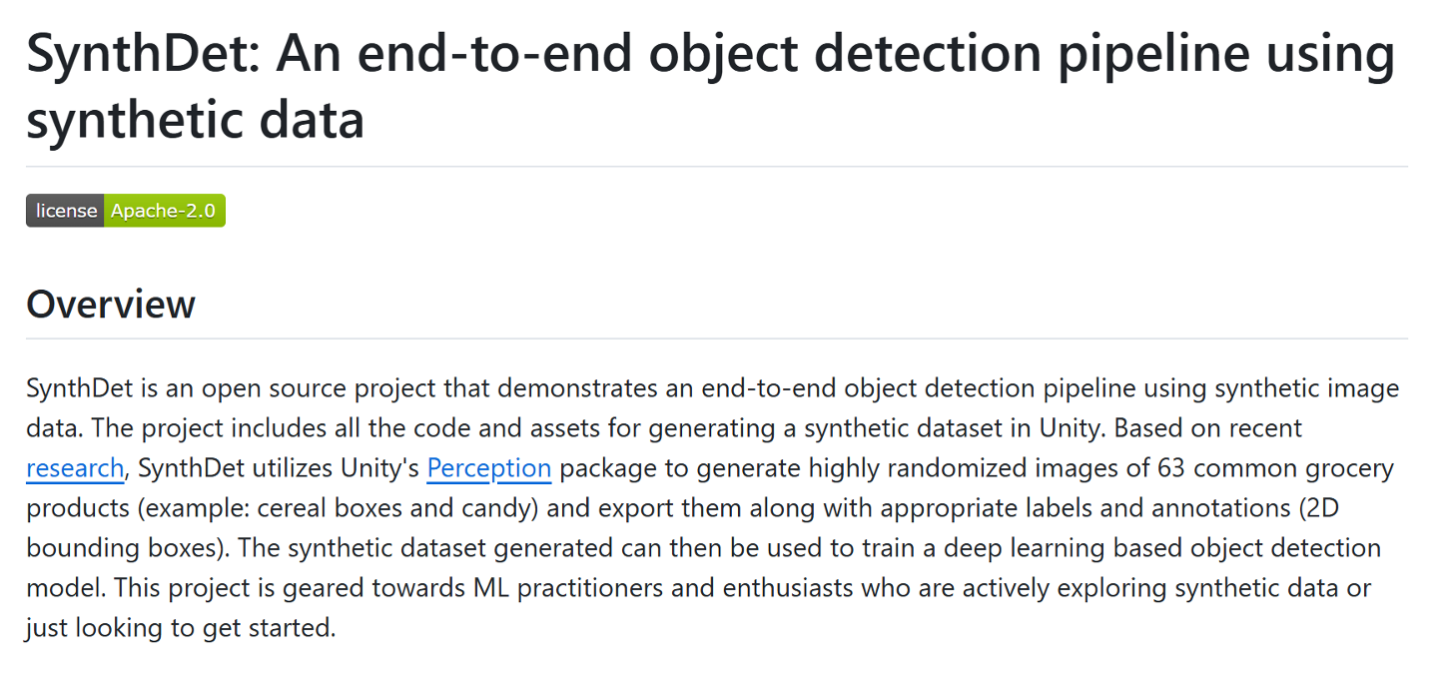
Project Challenge 3
Related project

Slide 30
Project Challenge 3
1.Environment Setup
- Scene Configuration
- Labeling
2.Randomization
- Object Placement
- Lighting and Background
3.Data Capture
- Frame Capture
Data Generation Pipeline

Slide 31
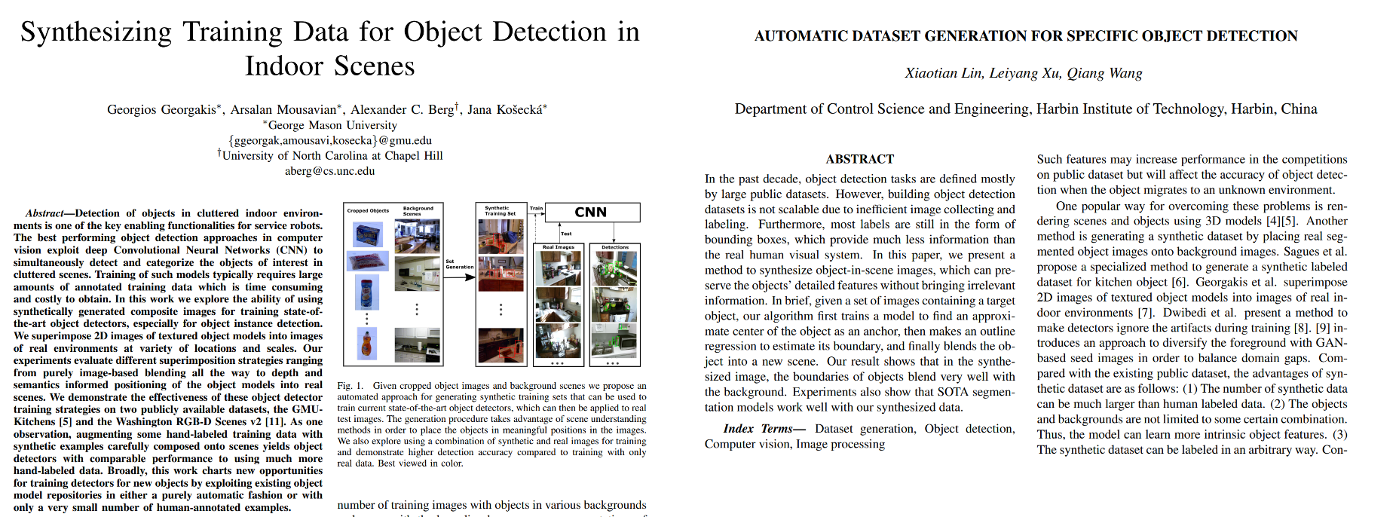
Project Challenge 3
Related reference

Slide 32
04
Next week plan

Slide 33
Things to be done until next week
Frontend
AI
Backend
Implementing workout page
Implementing profile page
Apply full design
Integration, Fix bugs
Improve accuracy of nlp model
Implementation for photo analysis
Implementing workout recommendation algorithm
Implementing workout related apis
Integration, Fix bugs

Slide 34
THANK YOU

